Slide 1
Sale Price Predictions
Crystal Ball created by
Michael Powers

Slide 2
Data Sample

Slide 3
Features of the Data
Item ID
Price Purchased
Quantity in Stock
Date Purchased by Store
Date put on Shelf
Date Purchased by Customer
Weekly Sales
Monthly Sales
Quarterly Sales
Yearly Sales
Expiration Date
Is Product Seasonal
Initial Release Date
Allergy Warning
Is Product Damaged
Is Product on Sale

Slide 4
What models were used?
Dummy (dr)
Linear (lr)
Random Forest (rfr)
Decision Tree (dtr)
Light Gradient Boost Model (lgbm)
Cat Boost (cbr)

Slide 5
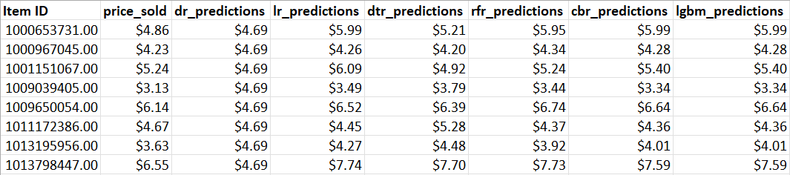
Price Sold versus Models’ Predictions

Slide 6
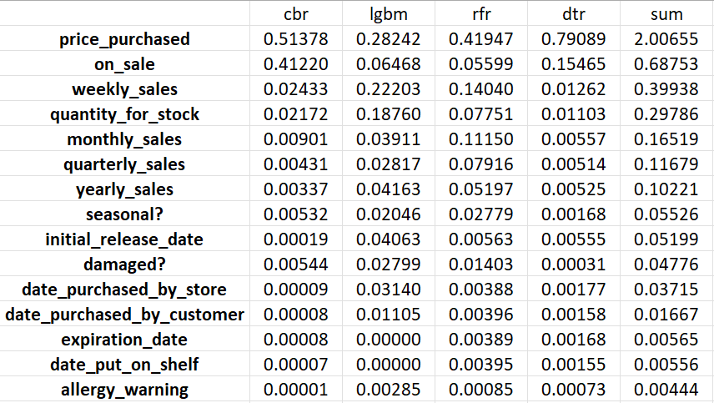
How Important are the features?

Slide 7
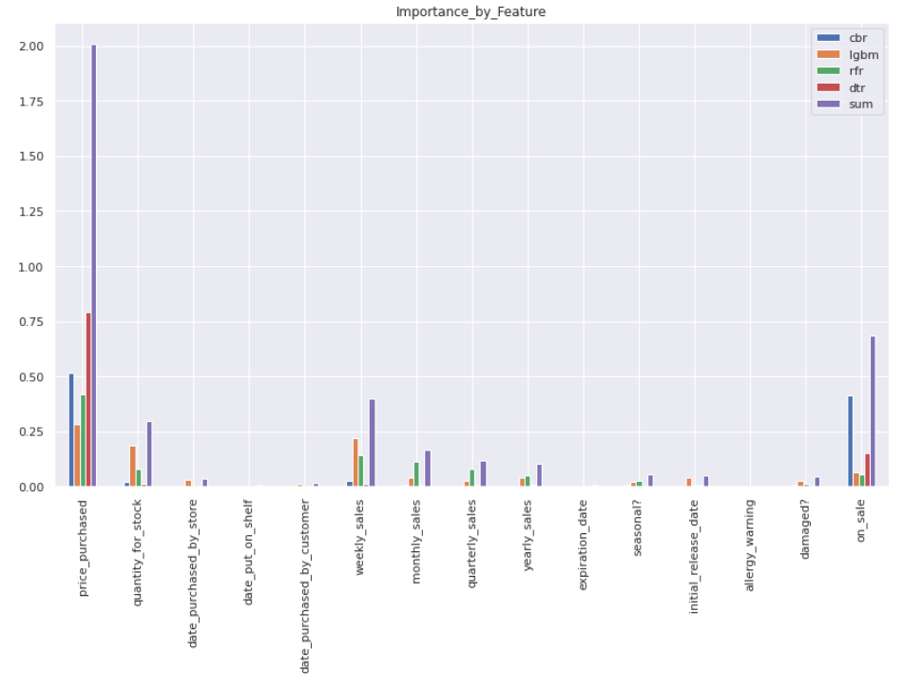
How Important are the features?

Slide 8
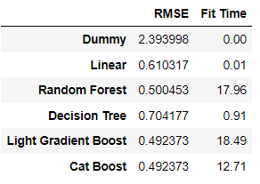
Average Error and training time per model
RMSE: Root Mean Squared Error
Fit Time: Time in seconds it takes to train each model

Slide 9
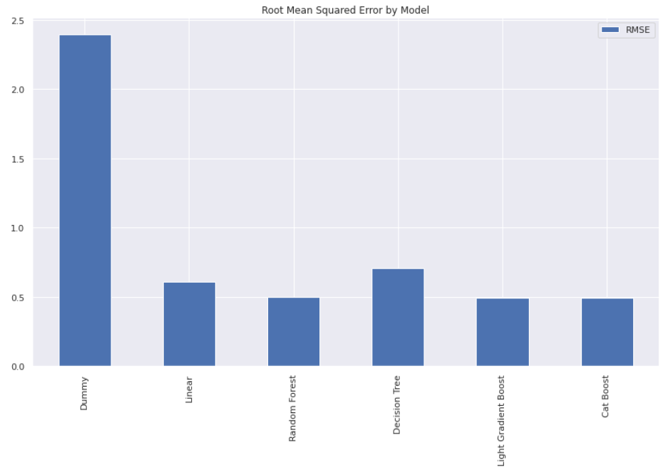
Average Error Graphics

Slide 10
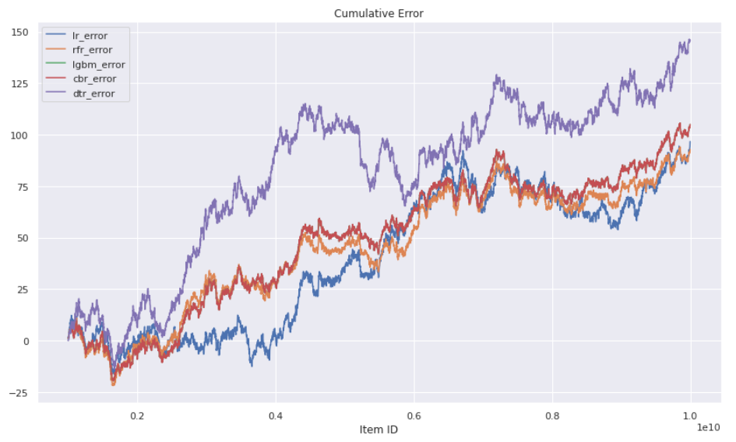
Cumulative Error per model over full Dataset

Slide 11
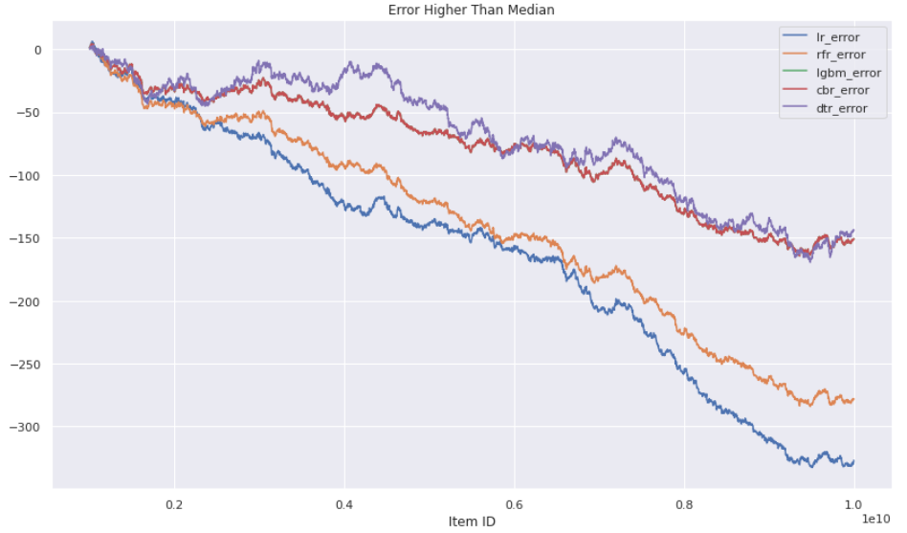
Cumulative Error over high priced items

Slide 12
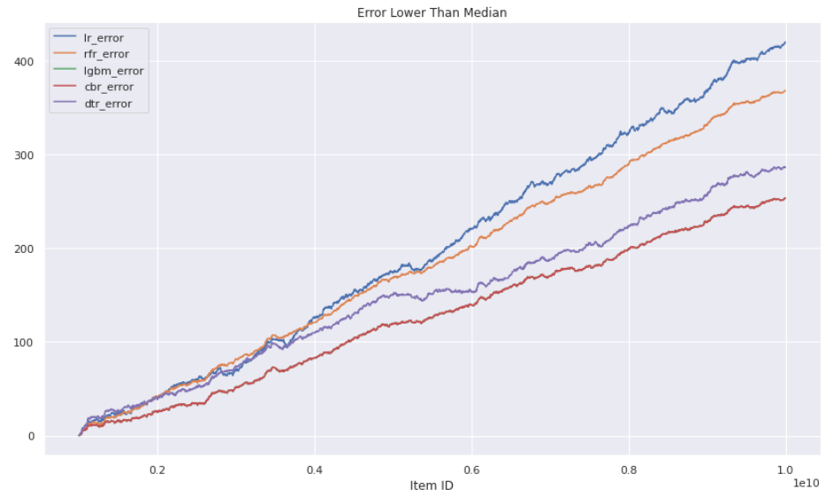
Cumulative error over low priced items

Slide 13
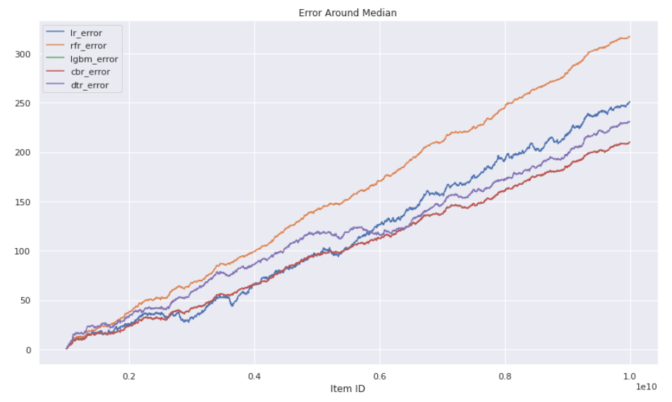
Cumulative error over average prices

Slide 14
Final thoughts
Links to Full Data
https://docs.google.com/spreadsheets/d/1cDBpQyWIqcsF81yabU4Hh2Wsj5QapHXI5QAvAfFwYII/edit?usp=sharing
https://docs.google.com/spreadsheets/d/1VKdWZUh7Wr05nJyzJTlpuckOTPYUrrRiQi5AqRzj4HU/edit?usp=sharing

